Slide 1

The 7Habits of Highly Effective People
Book by Stephen R.Covey

Slide 2
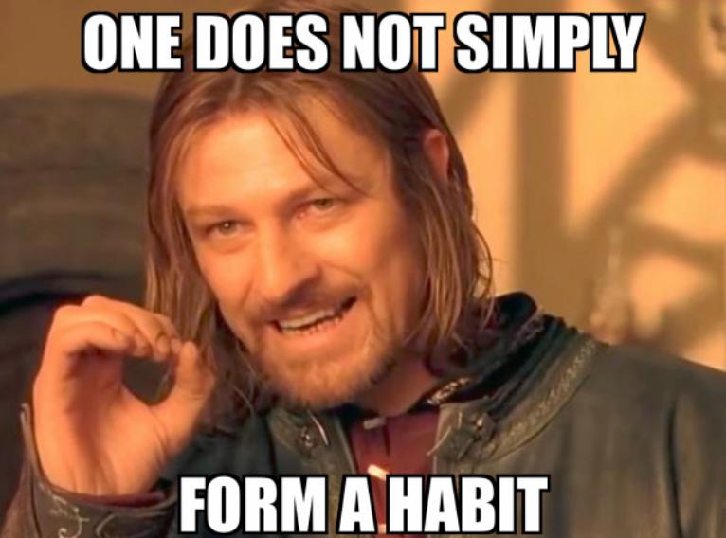
What is a habit
It’s a ritual formed or to be formed:
Knowledge (Why and What)
Skill (How )
Desire ( Motivation )

Slide 3
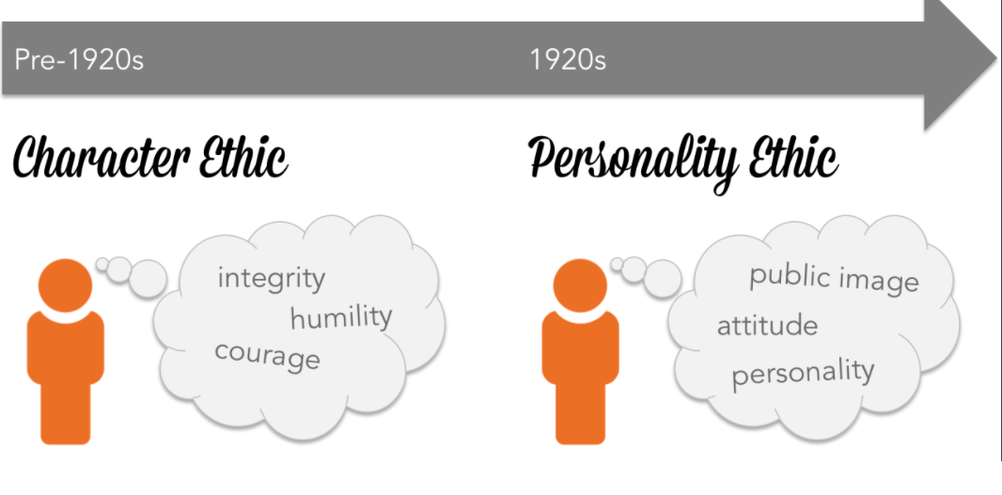
Character > Personality Ethic
Both are important
But one is important first
What if you have the map of Afghanistan but dropped into Iran
Character forms the foundation. This is key, before we move to personality.

Slide 4
We all want a quick fix?
The way we see the problem is the problem
Can’t I just post a video on tiktok, and get super popular
If I just buy her/him an expensive present, things will work out
If my kid doesn’t pass, will just send to boarding school
I just need to impress my boss, and will be promoted
How did you get successful in few years, can you give me the tips
I will put him on an innovation project for a month, and I will retain his loyalty

Slide 5
Can I shift my paradigm
From Next Monday Lets form our scrum teams
In principle ain’t we already agile?
Why do we have to do those unnecessary extra meetings?
All the anti-vaxers are so stupid
Does everyone perceive or should perceive information similarly?
Was everyone educated equally?
Do we all encounter fear equally and at the same time?

Slide 6
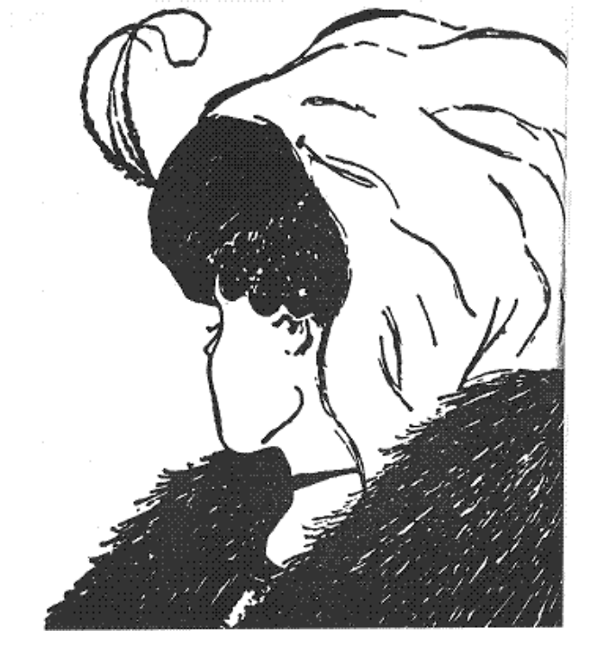

What do you see?

Slide 7
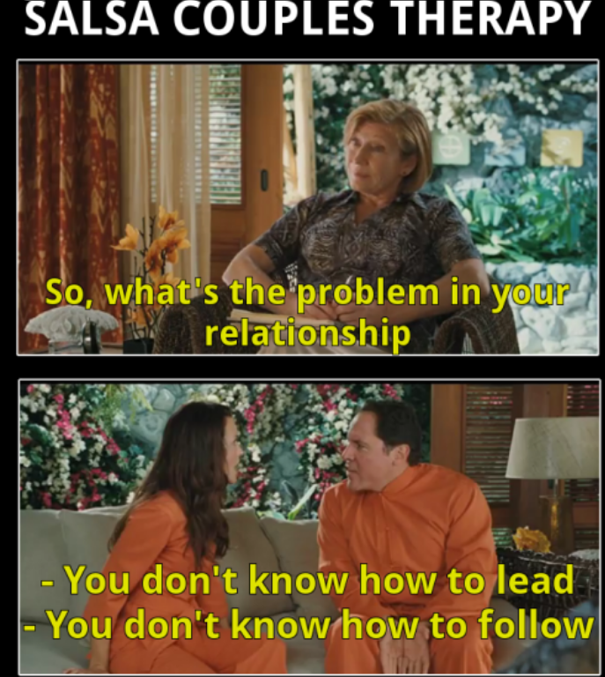
Inside Out
Start with self
When I can keep my own promises, then I could keep and deliver on promises to others

Slide 8
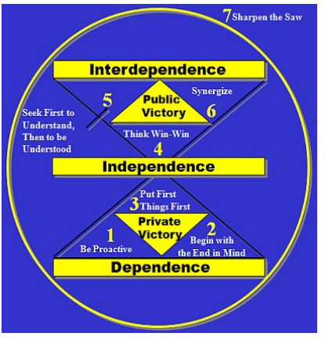
The 7 habits

Slide 9
Why the 7 habits
P/PC Balance: The production of golden eggs and production capability of the goose
The independent thinking is only private victory
The interdependence is where public victory lies
Cannot attain interdependence without being independent
Times change, finance change, humans change, physical needs change,
We need to update our operating system
Need to sharpen that saw

Slide 10
Habit 1 (Be Proactive, not Reactive)
I cannot buy the house because economy is bad
It’s the fuel prices again
Government is always increasing the taxes
What is the point to learn and do machine learning, when our customers don’t understand it
Can we control the economy? If not maybe we can control how to invest in the tough times?
Can we control the oil prices? If not maybe can control how to commute to work, e-bike, train.
Can either educate our customers, or make information easy to digest, if there is potential ROI

Slide 11
Habit 2 (Begin with the end in Mind)
You have come to a funeral. What if its yours:
What would you like your mates to say about you?
What would you like your subordinates say about you?
What would you like your family say about you?

Slide 12
Nakul’s Values
I will not deceive myself, and if I can be honest with myself, I believe I will be honest with the world. I will help out people in need, also guide people to help themselves
I will share my learnings with the world, because it is something I can easily give and share, and I believe a lot of people can get a lot out of it. I will continue to persevere in the hardest moments, keep pushing and trying to win. Money will be for hygiene and to enjoy life, but not a priority. I will give back of what I have borrowed from the environment, from people. Will stay away from things which can cause someone harm.
I will be kind and want to listen.

Slide 13
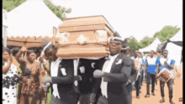
Nakul’s Funeral
Friends: He was generous , and I could rely on him
Future Generation: Uncle Nakul made sure we have parks to play and fresh air to breathe
Mentees, Students: Learnt so much from him, he always understood us, I am grateful for all the learnings, has changed my life, and has given me opportunity to improve the lives of others
But wife and kids: He has done a lot for others, but didn’t get much of his time. Mom taught me how to ride a bike. I will miss he being around, but his departure doesn’t feel like a great loss.

Slide 14
Nakul’s values updated
.. Cont..
I will be there when my wife gives birth
I will be there to take photos
I will take them to their games, read them bed time stories, make them breakfast
I will plan romantic dates with my wife, and help her manage the house

Slide 15
Imagine a dead Honeysuckle Health
One comment: It was due that organisation that my husband lived extra years
Government: It is due to people and their integrity, that NSW has become such a liveable state, people have learnt to monitor and manage their health. People have come across to trust the government system and they are now engaging and working together
Clients: They have helped us reduce customer churn, our profits improved, our NPS jumped the roofs, we are so proud we made a difference.

Slide 16
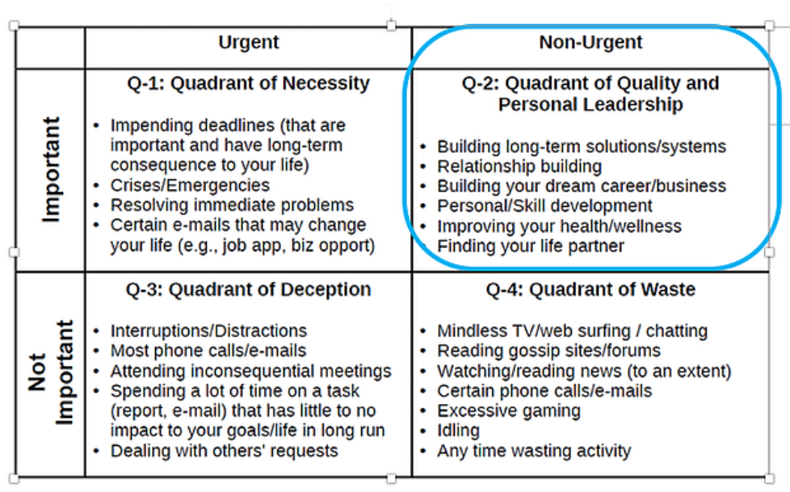
Habit 3: Put first things first
Is there a disconnect between of what I said vs what I do?
How do you schedule?
Daily
Weekly
Hourly
What do you schedule?
Only work
Or other things you spoke about in Habit 2

Slide 17
Habit 4: Think Win-Win
Win – Lose (Win short term, but may lose long term)
Lose – Win (Unhappy, always living at the mercy of someone)
Lose – Lose (If I don’t win, then I won’t let you win too)
Win – Win (Lets give a free program to NIB customers, this will also help save NIB money, and also help Honeysuckle win business)
Lets provide some training to our employees, this will help them in their personal growth and also improve how they work
Win-Win or No deal (If we cannot come into consensus, then its no deal)

Slide 18
Habit 5: Seek First to Understand and then to be Understood
Do we really try to understand someone or we are open to advice
Ah man my house is a mess. “You should schedule time once a week, to clean a little”
Ah my back hurts. “Get a massage dude”
Or?
Ah man work is boring? “Work is going boring eh”?
Ah I cannot get this to work? “Your computer is acting strange eh”?
No computer is ok, but program is giving bad results. “Does the program always does it or is it this time”?
Not always but over the last few days. “What did you do when this last happened”?
Nothing, maybe I should contact support. “Yeah, will support team respond immediately”?
From the past experience, they have been a little slow, but maybe if I increase the priority to High I am sure they will assist”

Slide 19
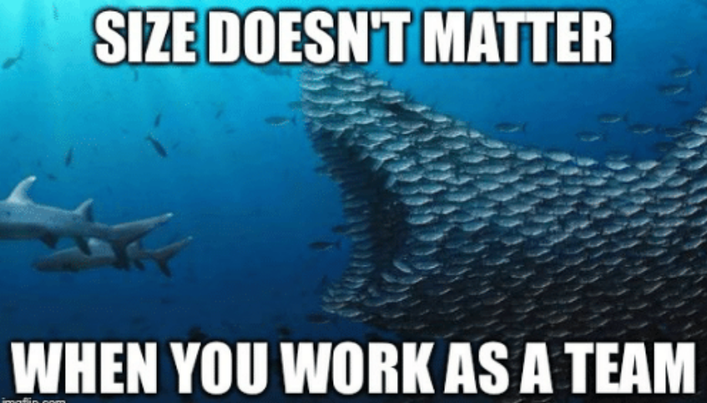
Habit 6: Synergize
What is 1+1?
2
5
10
20
All of the above
A husband and wife together can make a better home for their kids, and rest of the family, than one person
Liam cannot fix all the cultural problems by himself. Once a month we do a survey, out of which notes and action items are taken

Slide 20

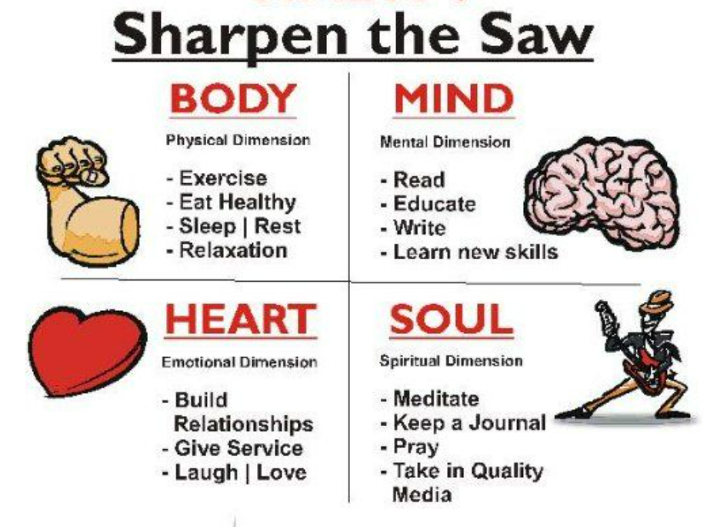
Habit 7: Sharpen the Saw

Slide 21
Thank you
Questions?

